Slide 1


Slide 2
What we are going to do now ?
OO Approach

Slide 3


Slide 4
Object Oriented Paradigm
So far, you’ve built two kinds of C++ programs:
Procedural: The program moves through a linear series of instructions.
Functional: The program moves from one function to another.
But there is another very common way to structure C++ code: object-oriented programming.
The main difference between object-oriented analysis and other forms of analysis is that in object-oriented approach, requirements are organized around objects, which integrate both data and functions.
Notes:
Object-Oriented Modelling (OOM) technique visualizes things in an application by using models organized around objects. Any software development approach goes through the following stages −
Analysis,
Design, and
Implementation.
In object-oriented software engineering, the software developer identifies and organizes the application in terms of object-oriented concepts, prior to their final representation in any specific programming language or software tools.

Slide 5
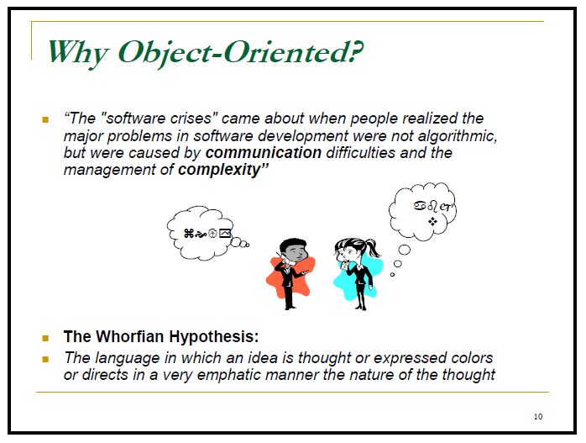

Slide 6
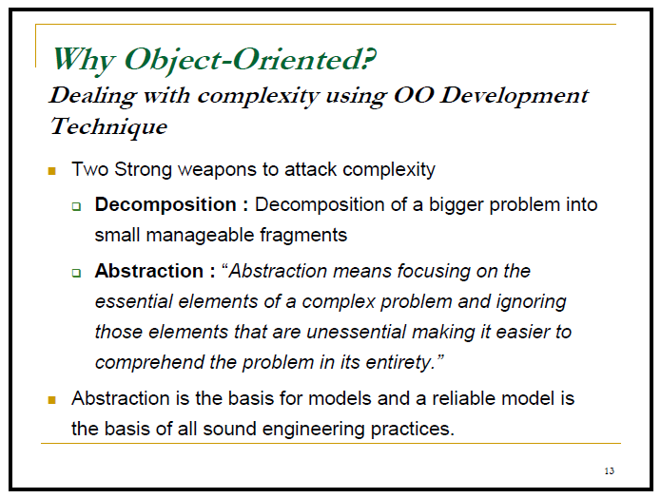

Slide 7
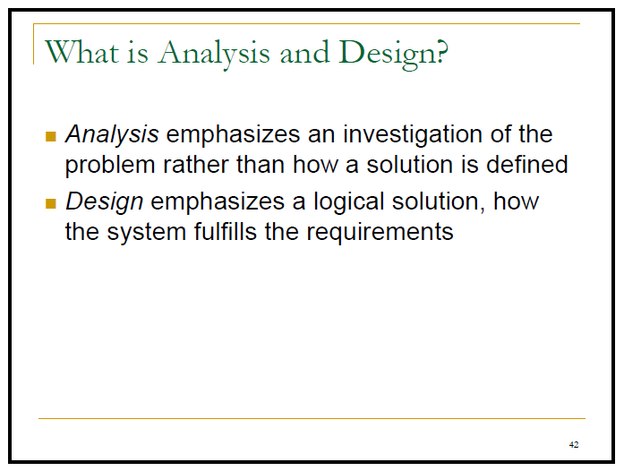

Slide 8
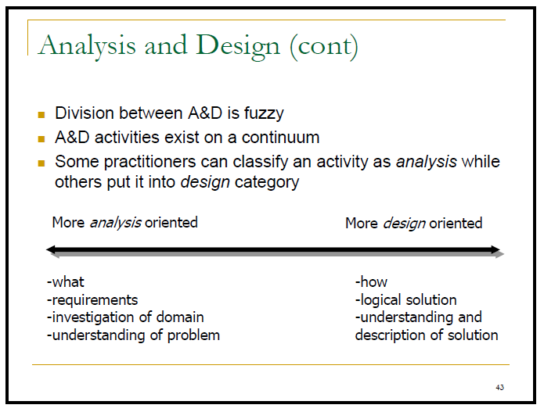

Slide 9
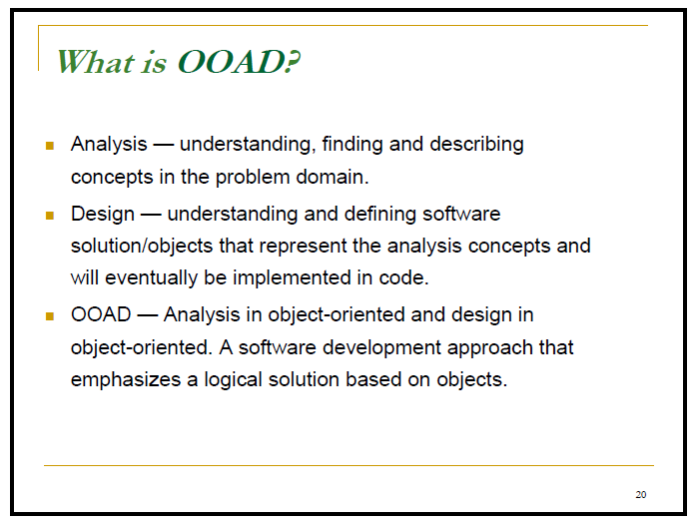

Slide 10
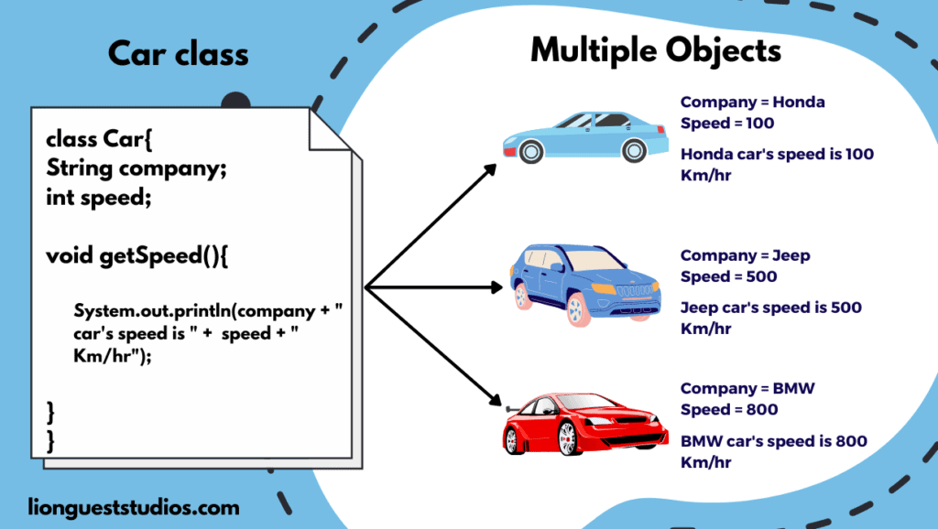

Slide 11
Introduction of Petri Nets

Slide 12
Basics of Petri Nets
Petri nets describe complex procedures and model the workings of a system.
Petri nets use elements like places, transitions, arc & token to describe this complex procedures.
A Petri net is also known as a place/transition net.
Petri Net (PN) is a bipartite graph.
Notes:
In a finite state machine the active state changes in response to an event. In a Petri net transitions are executed as soon as all input locations contain at least one token

Slide 13
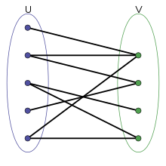
Bipartite Graph
A bipartite graph is a graph whose vertices can be divided into two disjoint and independent sets U and V such that every edge connects a vertex in U to one in V.
Notes:
Blue and green dots are vertex
Edge= Line

Slide 14
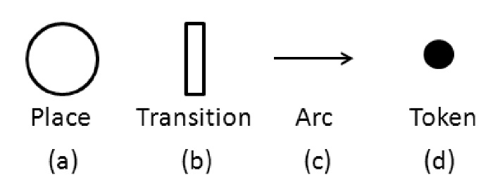
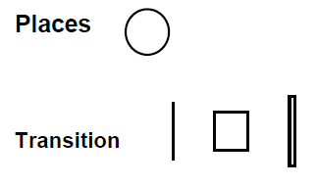
Basics of Petri Nets
PN contains the following elements.
Place (where you store something or It represents some sort of conditions that has to be satisfied).
Transition (represents some event that occur/ or some processing activity that takes place).
Tokens (represented by dots) are located at places in PNs. When a transition fires, it removes a token from each input place of the transition, and puts a token to each output place of the transition.
Tokens are values that circulate through the graph.

Slide 15
Basics of Petri Nets
The places and transitions are connected by directed edges, we also call them arcs.
Arcs exists only between a place and a transition or vice-versa.
A transition is enabled if all places connected to it as inputs contain at least one token.
The place circles may encompass more than one token to show the number of times a place appears.
Edges/Arc

Slide 16
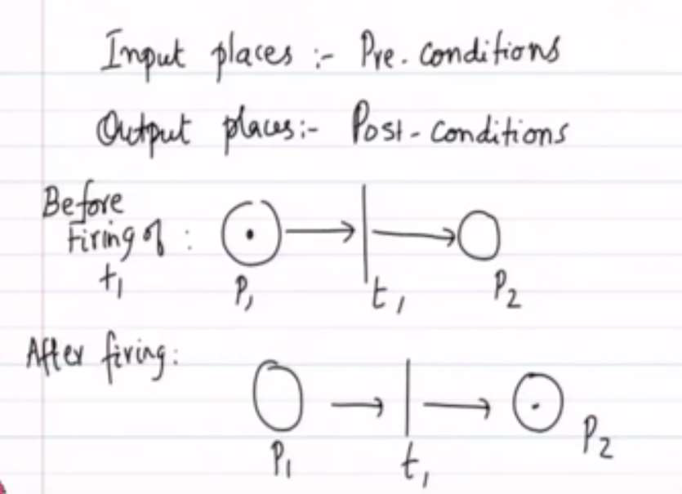
Firing rules Fra
Firing in 3 phases:
Phase 1- tokens are removed from the input places,
Phase 2- the delay time associated with the transition elapses,
Phase 3- tokens are deposed in the output place.

Slide 17
Pre-Condition & Post Condition

Slide 18
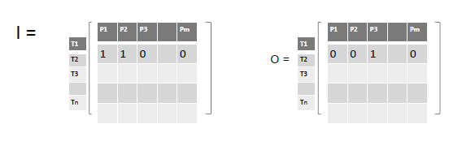
Incidence Matrix
Incidence matrix is a logical matrix that shows the relationship between two classes of objects
P= Set of places ={P1, P2,….. Pm}
T= Set of transitions={T1,T2,……Tn}
‘I’ is the matrix that basically tells you, which are the different input places that are associated with the corresponding transition. The entries will be either 1 or 0
Likewise there is ‘O’ matrix also, that will specify for each transition the corresponding output places
Notes:
P= Places
T= Transition
The cardinality of a set is a measure of a set's size, meaning the number of elements in the set. For instance, the set A = { 1 , 2 , 4 } A = \{1,2,4\} A={1,2,4} has a cardinality of 3 for the three elements that are in it.

Slide 19

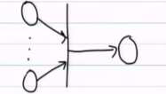
Sequences of PN
Sequential Action
Dependency
P1
P2
P3
T1
T2
P1
T1
P3
P2

Slide 20
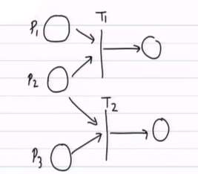
Conflict in PN
If p1 and p2 will have tokens and not p3, then T1 will be fired.
If p2 and p3 will have tokens, and not p1, then T2 will be fired.

Slide 21
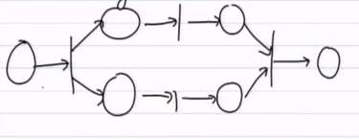
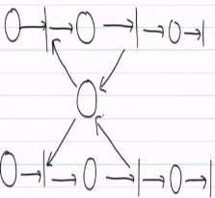
Concurrency & Resource Sharing

Slide 22
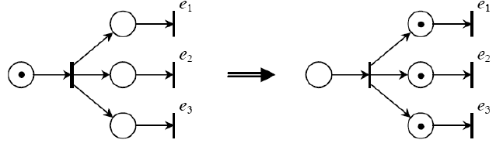
Parallelism
More events are simultaneously enabled

Slide 23
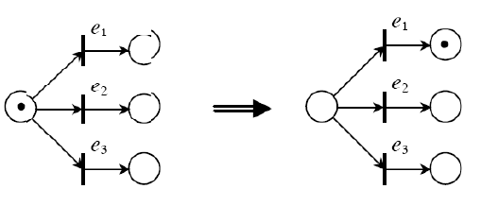
Choice
More events are enabled, just one can occur.

Slide 24
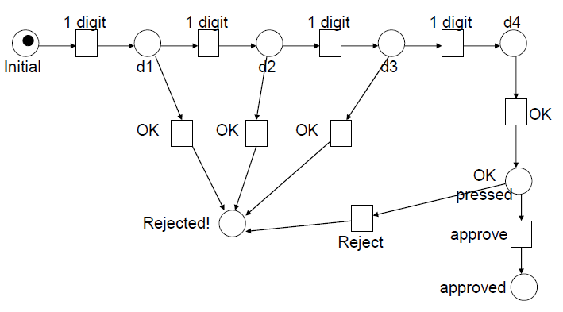
EXAMPLE 01: POS (PETRI NET) Fra
Notes:
In this example person can only enter 4 digits only. Then system will approve the purchase.

Slide 25
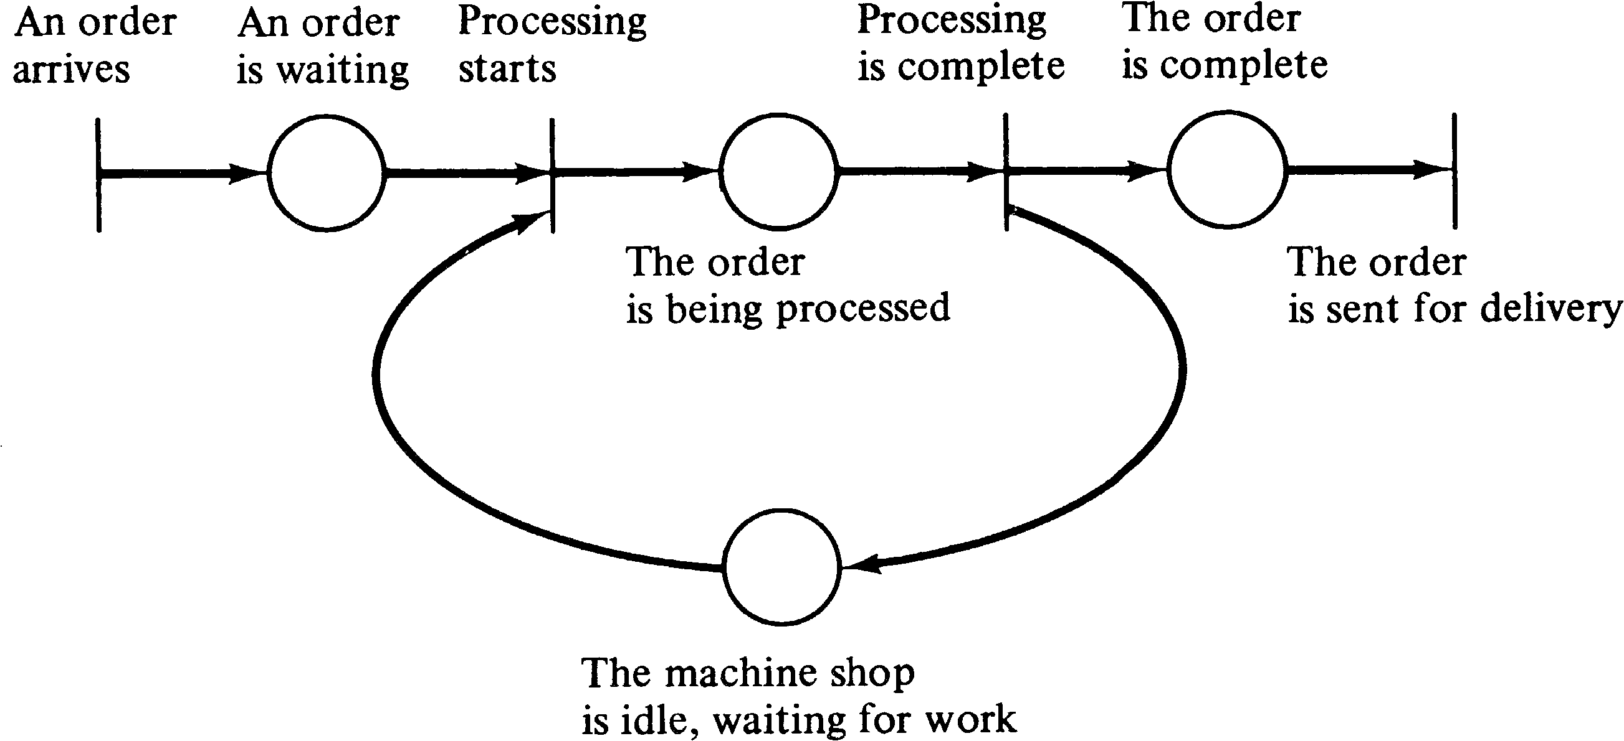
EXAMPLE 02 : Factory Machine Order Fra
T1
T2
T3
T4
P1
P2
P3
P4

Slide 26
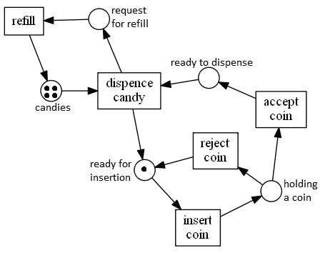
EXAMPLE 03 : Candy Dispense Machine Fra

Slide 27
Recall Petri Nets
Arc

